Slide 1
4-Bit Ripple Carry Adder
FA0
C1
FA1
C2
FA2
Design, working and carry propagation delay
C3
FA3
Notes:
Introduce the topic: a 4-bit ripple carry adder built from four identical full adders. The carry produced by each stage feeds the next, which is what gives the adder its name and its main limitation, delay.

Slide 2
What is a ripple carry adder?
1
Adds two 4-bit numbers
Takes A, B and a carry-in, and produces a 4-bit sum and a carry-out.
WHAT IT COMPUTES
A3 A2 A1 A0
+ B3 B2 B1 B0
+ Cin
= Cout S3 S2 S1 S0
Adding two 4-bit numbers needs 5 output bits.
2
Built from four full adders
One identical full adder per bit position.
3
Carry ripples from LSB to MSB
Each stage waits for the carry from the stage before it.
Notes:
A ripple carry adder adds two n-bit numbers by chaining n full adders. For four bits we have A3..A0 and B3..B0 plus a carry-in, and we get four sum bits and a carry-out.

Slide 3
The full adder: the building block
A | B | Cin | Sum | Cout
0 | 0 | 0 | 0 | 0
0 | 0 | 1 | 1 | 0
0 | 1 | 0 | 1 | 0
0 | 1 | 1 | 0 | 1
1 | 0 | 0 | 1 | 0
1 | 0 | 1 | 0 | 1
1 | 1 | 0 | 0 | 1
1 | 1 | 1 | 1 | 1
SUM
A XOR B XOR Cin
CARRY OUT
A·B + Cin·(A XOR B)
Sum is 1 when an odd number of inputs are 1. Cout is 1 when two or more inputs are 1 (highlighted rows).
Notes:
Walk through the truth table. Sum is the XOR of the three inputs. Carry-out is 1 whenever at least two inputs are 1. The amber cells mark every case where a carry is produced.

Slide 4
Full adder at gate level
A
XOR
XOR
Sum
B
AND
OR
Cout
Cin
AND
P = A XOR B (propagate)
G = A · B (generate)
2 XOR + 2 AND + 1 OR
Notes:
Two half adders plus an OR gate. The first half adder produces P = A xor B and G = A and B. The second adds P and Cin to give the sum. Cout = G + P·Cin. The amber path is the carry path, which matters for the delay analysis later: from Cin to Cout there are only two gate delays (AND then OR).

Slide 5
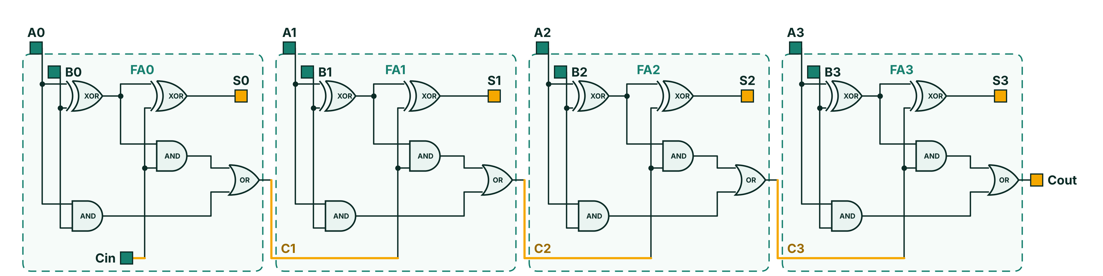
4-bit ripple carry adder: the circuit
One full adder per bit
Each dashed box is FA0 to FA3: 2 XOR, 2 AND and 1 OR gate.
Carry ripples left to right
The amber wire carries C1, C2 and C3 into the next stage.
20 gates in total
Cin is 0 for plain addition; Cout is the 5th result bit.
Notes:
This is the circuit built in Logisim: four full adders in a row. Inputs A0-A3 and B0-B3 enter at the top, sum bits S0-S3 leave at the top right of each stage, and the amber carry wire runs from the OR gate of one stage to the carry-in of the next. Cin of the first stage is 0 for plain addition and the carry-out of FA3 is the fifth bit of the result.

Slide 6
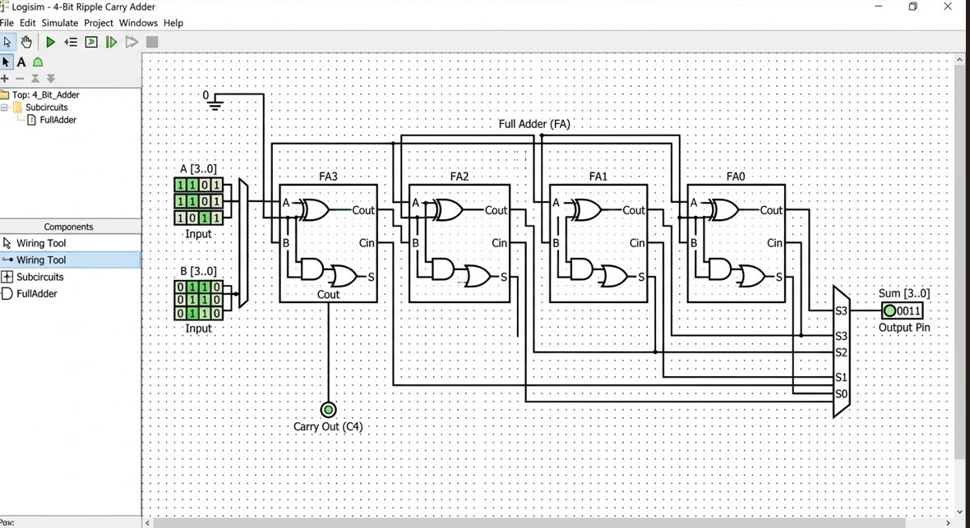
Built and tested in Logisim
FullAdder subcircuit
Built once, then used four times as FA0 to FA3.
Splitters and constant 0
Split A[3..0] and B[3..0] into bits; Cin of FA0 is tied to 0.
Outputs
Sum[3..0] shows the result and Carry Out (C4) lights for a carry.
Sample run: A = 1101 and B = 0110 give Sum = 0011 and Carry Out = 1 (13 + 6 = 19).
Notes:
This is the circuit running in Logisim. The four FullAdder subcircuits FA3 to FA0 sit in a row, with the most significant bit on the left. A and B come in through splitters, the first carry-in is tied to a constant 0, and the Sum pin and Carry Out pin show the result. In this run 1101 + 0110 gives 10011, so Sum is 0011 and Carry Out is 1.

Slide 7
Working example: 1011 + 0110
Stage | Ai | Bi | Cin | Si | Cout
FA0 | 1 | 0 | 0 | 1 | 0
FA1 | 1 | 1 | 0 | 0 | 1
FA2 | 0 | 1 | 1 | 0 | 1
FA3 | 1 | 0 | 1 | 0 | 1
1011
+ 0110
= 10001
Cout = 1, S3S2S1S0 = 0001
11 + 6 = 17
Stages are evaluated in order: FA0 first, FA3 last. Amber cells show the carry moving from stage to stage.
Notes:
A = 1011 (11), B = 0110 (6). FA0: 1+0+0 gives sum 1, carry 0. FA1: 1+1+0 gives sum 0, carry 1. FA2: 0+1+1 gives sum 0, carry 1. FA3: 1+0+1 gives sum 0, carry 1. Result is Cout=1 and sum 0001, i.e. 10001 = 17.

Slide 8
How the carry ripples
P = A XOR B G = A · B C(i+1) = G(i) + P(i) · C(i)
G
Generate
P
Propagate
K
Kill
A = B = 1. The stage creates a carry by itself, whatever Cin is.
A ≠ B. The stage passes the incoming carry on unchanged.
A = B = 0. Carry out is 0, whatever came in.
Worst case: A = 1111, B = 0001, Cin = 0. Bit 0 generates a carry and bits 1 to 3 propagate it, so C4 must wait for every stage.
Notes:
Each stage either generates a carry, propagates one, or kills it. The recurrence C(i+1) = G(i) + P(i)·C(i) shows each carry depends on the previous carry, so it cannot be computed until that one is ready. The worst case is a carry generated at bit 0 that propagates through all remaining stages.

Slide 9
Carry propagation delay
DELAY OF Cout
t(XOR) + n·(t(AND) + t(OR))
= (2n + 1) gate delays
n = 4 → 9 gate delays
Each stage adds 2 gate delays (AND, then OR). The last sum bit S3 settles one XOR after C3, at 8 gate delays. With 1 ns per gate, the 4-bit adder needs 9 ns.
Notes:
Assume all inputs arrive at time zero and every gate takes one unit. The first stage produces C1 after XOR, AND, OR = 3 units. Every later stage adds AND + OR = 2 units, so C2 = 5, C3 = 7, C4 = 9. In general Cout takes 2n + 1 gate delays. The final sum bit S3 is ready at 8 units.

Slide 10
Delay grows linearly with word length
4-bit adder
8-bit adder
16-bit adder
32-bit adder
9
17
33
65
gate delays
gate delays
gate delays
gate delays
Delay = (2n + 1) gate delays, so doubling the width roughly doubles the delay.
Every extra bit adds one more carry stage to the critical path.
A 4-bit carry-lookahead adder computes carries in parallel and needs only about 3 to 4 gate delays.
Notes:
Using the 2n + 1 formula: 4 bits = 9, 8 bits = 17, 16 bits = 33, 32 bits = 65 gate delays. That linear growth is the reason ripple carry adders are not used for wide, fast arithmetic. Lookahead adders break the dependency on the previous carry.

Slide 11
Summary
Strengths
Limitation
Faster options
Simple, regular design
Only 20 gates for 4 bits
Easy to extend to n bits
Delay of (2n + 1) gate delays
The carry chain sets the speed
Slows down as width grows
Carry-lookahead adder
Carry-select adder
Carry-skip adder
Simple and cheap, but its carry chain makes it slow as the word length grows.
Notes:
Wrap up: the ripple carry adder is the simplest adder, four full adders with 20 gates, but its delay grows linearly with width. Faster designs such as carry-lookahead trade extra hardware for lower delay.

